Slide 1
Q&A Session April 22, 2020
COVID-19: How to apply the
Minimum Economic Recovery Standards
to the new context
Notes:
KEY MESSAGE
“Welcome to the MERS workshop”
__________________________________________________________________
FACILITATOR SLIDE NOTES
Welcome participants to the workshop as the come in. Introduce yourself and encourage them to complete sign in sheets.
ACTIVITY MATERIALS
Sign in sheets

Slide 2
Speakers
Karri Byrne
Senior Market Systems Advisor
MERS Focal Point Facilitator
Sarah Ward
Senior Independent Consultant
MERS Focal Point Facilitator
Katie Whitehouse
Market & Social
Innovation Consultant
MERS Focal Point Facilitator
Sonya Salanti
Senior Program Manager
The SEEP Network

Slide 3
Today’s Session
Brief overview of MERS (5m)
Discussion of new guidance (15m)
Q & A with MERS “experts” (45m)
What we would like from you:
Ask questions in the Q&A box
Download the MERS and new guidance at www.mershandbook.org
Send us examples of how your team is adapting your programs to resilientmarkets@seepnetwork.org
What we can offer you today:
Guidance from technical advisors who helped to write the MERS
Examples of what other organizations are doing to adapt
A place you can feel free to ask any question
Notes:
KEY MESSAGE
“Today we figure out the MERS are”
______________________________________________________________
FACILITATOR SLIDE NOTES
Explain to participants where bathrooms are located, the duration and frequency of breaks, and where they will find tea/coffee/water and lunch (if included)
Discuss the ground rules:
Be on time: This one is pretty self explanatory – please be on time when coming back from breaks, and lunch. Lots of material to get through, so following the clock is important.
Focus to learn: Everyone is an adult, a professional and is in this workshop to learn something that will support their effectiveness in their jobs. To learn, and to support others’ desire to learn - try to stay focused on the content (we promise not to make it boring!); engage in the activities and take advantage of the time away from the day to day of the job.
Tend to your business: We recognize there may be things you need to tend to as part of your work. If possible, use break time and lunch, but if you need to check emails, make calls– we understand. Just be careful not to distract your fellow classmates. Silence your cell phone.
Share the stage: This course is designed to be highly interactive – and we are here to learn from one another. Speak up and engage in discussion, but also allow others to share and participate.
Make notes: get your highlighters, sticky notes, pads out and write down your thoughts. How you capture new information so you can learn best is down to you too!
We are all friends here: All of us here are peers, colleagues and hopefully friends at the end of the day. As facilitators, we aim to foster an environment of safety, and we need your help in doing that. Let us all agree to speak freely and openly, with kindness! The work you do is challenging – there may be sensitive issues that come up. Please respect the community we create in this room and aim to be supportive, attentive and active listeners and to share from your personal experience. Refrain from giving advice unless it is requested. Most of all, have fun and enjoy yourselves.
Use the parking lot: if you have a question but want to remain anonymous or can’t find an appropriate time to ask it then stick it on our parking lot. This will be checked by our facilitators throughout the day and time will be taken to address people’s question or thoughts.
Note – it may be useful to exclude some from the list and ‘plant’ someone to provide one of the rules to encourage audience participation
Allow time to add and ask questions: Is there anything to add here? Any comments about these ground rules?
ACTIVITY MATERIALs
Parking lot
Post-it note

Slide 4
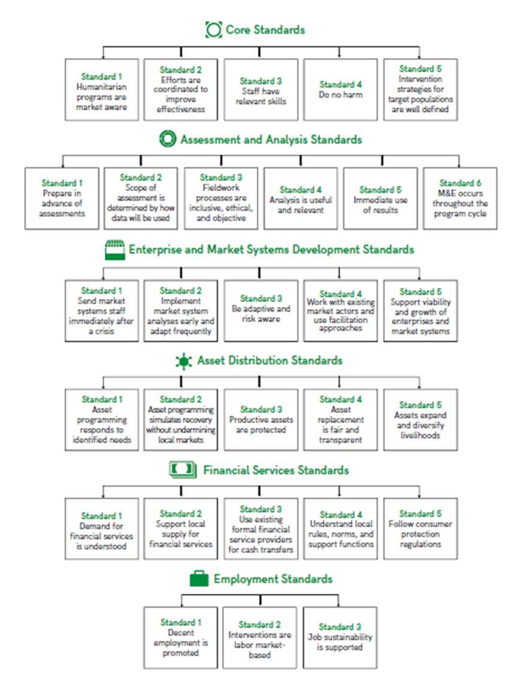
The MERS – your quick guide!
The MERS on a page
Notes:
KEY MESSAGE
“The ‘MERS on a page’ is your quick find guide.”
__________________________________________________________________
FACILITATOR SLIDE NOTES
Ask participants to open their Handbooks to p1 to get a better visual of the Standards overall
Here are the six Categories of Minimum Standards. You do not need to necessarily understand how to implement these if it is not your role. You do need to know that they exist and find the right team to implement them (or upskill teams to delivery them).
In summary these standards are as follows:
Core Standards for Economic Recovery – similar to Sphere and other companion standards on preventing/mitigating harm, but applying market systems lens, these are the basic FOUNDATION standards that all programmes should be delivering at a minimum.
Assessment and Analysis – similar to Sphere and other companion standards on assessments and program monitoring, but applying market systems lens
Following analysis, the next standards supporting design and implementation of specific types of interventions that may be created from the outputs of your analysis:
Enterprise and Market Systems Development – Looks systemically at markets and how to support and strengthen them discussing different intervention techniques including facilitation and adaptive approaches
Asset Distribution – when relief goods are being distributed, especially livelihood-related goods, this provides guidance on market-aware ways to do distributions
Financial Services and Standards – guidance on how to use financial services post-crisis, and coordinate with cash programming
Employment – relates to activities that prepare individuals for work or create jobs (short-term or longer term)
On the next slides we will talk about how the standards are presented and how to read them
There is also a standardised glossary of terms – important as terms get conflated and confused on this topic and we need to be consistent in how we speak about them internally and externally
There is also a note of useful tools and frameworks to help design and implement market-based programmes should you need them.
ACTIVITY MATERIALS
Page 1 printout of MERS (all standards on a page) -> this is possibly one of the most useful views of the MERS. It may be worth considering printing them as a laminate for people to pin on walls at work OR creating an poster view of them in the training room.

Slide 5
If you have no time to read… still read these!
Core Standard 1:
Humanitarian Programs are Market-aware (p11)
All humanitarian programs should consult technical staff who can provide livelihoods and market advice
Identify where market actors are already making positive changes and reinforce the behavior
Immediate Action
Potential Future Action
Use MERS to review programs and identify where adaptation is necessary (due to COVID-19) or possible (to improve alignment with good practice)
Ensure adaptive management approaches are built into programs to ensure emerging data is used and programs are able to respond to change
Enterprise and Market System Standard 3:
Be adaptive and risk aware (p75)
Immediate Action
Immediate Action
Potential Future Action
Potential Future Action
Enterprise and Market System Standard 4: Work with existing market actors and use facilitation approaches (p79)
Immediate Action
Make a list of networks who may be able to help with various adaptation activities. Note any capacity building needs
Potential Future Action
Develop the facilitation skills of local actors and groups in order to strengthen recovery and resilience
Notes:
KEY MESSAGE
“The MERS offers a guide for all the scenarios you may find yourself working in.”
__________________________________________________________________
FACILITATOR SLIDE NOTES
On the previous slide we mentioned cross-cutting themes and changing priorities being focused upon in the new version of the MERS. This slide just provides a little more detail on those.
A lot has changed since 2010—the industry continues to learn and move forward—it was important that revised MERS reflected these changes.
The cross-cutting themes are: 1) gender; 2) disability; 3) preparedness; 4) resilience; 5) protection; and 6) environment. There is no standalone information for each theme as they will need to be considered across all the MERS to reflect project needs. Therefore, how to consider these themes by standard is provided.
The adoption of cash-based programming by organisations and donors – whom now ask ‘why not cash?’ – has necessitated the need to plan for and deliver cash-based programming effectively. It must be noted however that cash-based programming is one type of intervention that could be used to support/strengthen a market system. It is not the only form of market intervention nor is necessarily always the best option.
In recent years, there has been a major rise in crises and refugee and IDP numbers. There are more than 21.3 million refugees in protracted displacement, with the average duration for current refugees at 10.3 years. Zetter, R. (2016), ‘Protracted Displacement – Setting the Scene’, International Organization for Migration, 21 December 2016, http://weblog.iom.int/protracted-displacement-%E2%80%93-setting-scene#_ftn2.
There a number of market challenges that refugees and IDPs face in their isolation from livelihoods and restriction of movement. However, continuous aid for long-term challenges (particularly those that may hinder or create inequities between host and refugee populations) requires a different take,. A market-based approach to meeting refugee needs has been highlighted in the UNHCR 2017–21 strategic plan to deliver the Comprehensive Refugee Response Framework, wherein the agency aims to bring together development and private-sector actors to address ‘immediate and longer-term needs of refugees and host communities, and in supporting them to become resilient and self-reliant.’ The MERS looks to support practitioners in these efforts. Office of the United Nations High Commissioner for Refugees (2017), UNHCR’s Strategic Directions 2017-2021, http://www.unhcr.org/5894558d4.pdf.
Also there is increased emphasis on pointing out that in market analysis and interventions the target beneficiaries may not be exclusively the ‘vulnerable’. In order to support the vulnerable, it may be necessary to identify and support those that are less vulnerable (perhaps because they are the sole providers for their families or are able to maintain businesses or services to support the wellbeing or employment of others). They can be part of the market-based solution but may have been ignored in the past using traditional targeting approaches.
ACTIVITY MATERIALS
N/A

Slide 6
Overarching Standards still critical at this time…
Core Standard 2:
Efforts are Coordinated to Improve Effectiveness (p16)
Learn who is collecting data or guidance that may be valuable to you and your programs
Collaborate and share data you have gathered through networks
Immediate Action
Potential Future Action
Core Standard 4:
Do No Harm (p24)
Ensure your staff is informed how to keep safe and feel confident to stop work when they feel unsafe or in order to take care of family
Ensure that programs do not transmit the virus to areas not currently affected
Immediate Action
Future Action
Immediate Action
Assessment & Analysis Standard 1:
Prepare in Advance of Assessments (p40)
Immediate Action
Potential Future Action
Gather existing market data from multiple relevant sources, determine data gaps
Potential Future Action
Identify opportunities for shared data gathering with other organizations
Assessment & Analysis Standard 3:
Fieldwork is inclusive, ethical, objective (p51)
Immediate Action
M&E and program staff should work collaboratively to brainstorm challenges and opportunities for future assessments
Potential Future Action
Develop plans to continue data gathering that are as inclusive, ethical, and objective as possible
Notes:
KEY MESSAGE
“The MERS offers a guide for all the scenarios you may find yourself working in.”
__________________________________________________________________
FACILITATOR SLIDE NOTES
On the previous slide we mentioned cross-cutting themes and changing priorities being focused upon in the new version of the MERS. This slide just provides a little more detail on those.
A lot has changed since 2010—the industry continues to learn and move forward—it was important that revised MERS reflected these changes.
The cross-cutting themes are: 1) gender; 2) disability; 3) preparedness; 4) resilience; 5) protection; and 6) environment. There is no standalone information for each theme as they will need to be considered across all the MERS to reflect project needs. Therefore, how to consider these themes by standard is provided.
The adoption of cash-based programming by organisations and donors – whom now ask ‘why not cash?’ – has necessitated the need to plan for and deliver cash-based programming effectively. It must be noted however that cash-based programming is one type of intervention that could be used to support/strengthen a market system. It is not the only form of market intervention nor is necessarily always the best option.
In recent years, there has been a major rise in crises and refugee and IDP numbers. There are more than 21.3 million refugees in protracted displacement, with the average duration for current refugees at 10.3 years. Zetter, R. (2016), ‘Protracted Displacement – Setting the Scene’, International Organization for Migration, 21 December 2016, http://weblog.iom.int/protracted-displacement-%E2%80%93-setting-scene#_ftn2.
There a number of market challenges that refugees and IDPs face in their isolation from livelihoods and restriction of movement. However, continuous aid for long-term challenges (particularly those that may hinder or create inequities between host and refugee populations) requires a different take,. A market-based approach to meeting refugee needs has been highlighted in the UNHCR 2017–21 strategic plan to deliver the Comprehensive Refugee Response Framework, wherein the agency aims to bring together development and private-sector actors to address ‘immediate and longer-term needs of refugees and host communities, and in supporting them to become resilient and self-reliant.’ The MERS looks to support practitioners in these efforts. Office of the United Nations High Commissioner for Refugees (2017), UNHCR’s Strategic Directions 2017-2021, http://www.unhcr.org/5894558d4.pdf.
Also there is increased emphasis on pointing out that in market analysis and interventions the target beneficiaries may not be exclusively the ‘vulnerable’. In order to support the vulnerable, it may be necessary to identify and support those that are less vulnerable (perhaps because they are the sole providers for their families or are able to maintain businesses or services to support the wellbeing or employment of others). They can be part of the market-based solution but may have been ignored in the past using traditional targeting approaches.
ACTIVITY MATERIALS
N/A

Slide 7
Technical Standards that are particularly relevant right now…
Asset Distribution Standard 3:
Productive Assets are Protected (p104)
Gather data on activities to protect household and business assets (like CVA). Share information widely.
Design programs that fill CVA gaps, being sensitive to the potential for market distortions
Immediate Action
Potential Future Action
Financial Services Standard 2:
Support Local Supply for Financial Services (p124)
Gather data on financial services needs of the population and the ability of providers to meet those needs in light of the crisis
Do scenario planning looking at medium to long term outlook for local markets and the institutions that support them
Immediate Action
Potential Future Action
Immediate Action
Financial Services Standard 3:
Use existing formal financial service providers for cash transfers (p129)
Understand digital infrastructure in your area. Use local FS providers for distribution and also identify alternative delivery mechanisms.
Immediate Action
Invest in local payment systems, including solutions to address the digital divide and the capacity constraints of marginalized groups
Potential Future Action
Potential Future Action
Employment Standard 3:
Job Sustainability supported (p151)
Immediate Action
Identify solutions for employers to support employees and/or keep working. Share widely, to give good publicity to the employers and encourage other employers.
Potential Future Action
Identify long term employment trends for local markets and identify ways to support without distorting the market
Notes:
KEY MESSAGE
“The MERS offers a guide for all the scenarios you may find yourself working in.”
__________________________________________________________________
FACILITATOR SLIDE NOTES
On the previous slide we mentioned cross-cutting themes and changing priorities being focused upon in the new version of the MERS. This slide just provides a little more detail on those.
A lot has changed since 2010—the industry continues to learn and move forward—it was important that revised MERS reflected these changes.
The cross-cutting themes are: 1) gender; 2) disability; 3) preparedness; 4) resilience; 5) protection; and 6) environment. There is no standalone information for each theme as they will need to be considered across all the MERS to reflect project needs. Therefore, how to consider these themes by standard is provided.
The adoption of cash-based programming by organisations and donors – whom now ask ‘why not cash?’ – has necessitated the need to plan for and deliver cash-based programming effectively. It must be noted however that cash-based programming is one type of intervention that could be used to support/strengthen a market system. It is not the only form of market intervention nor is necessarily always the best option.
In recent years, there has been a major rise in crises and refugee and IDP numbers. There are more than 21.3 million refugees in protracted displacement, with the average duration for current refugees at 10.3 years. Zetter, R. (2016), ‘Protracted Displacement – Setting the Scene’, International Organization for Migration, 21 December 2016, http://weblog.iom.int/protracted-displacement-%E2%80%93-setting-scene#_ftn2.
There a number of market challenges that refugees and IDPs face in their isolation from livelihoods and restriction of movement. However, continuous aid for long-term challenges (particularly those that may hinder or create inequities between host and refugee populations) requires a different take,. A market-based approach to meeting refugee needs has been highlighted in the UNHCR 2017–21 strategic plan to deliver the Comprehensive Refugee Response Framework, wherein the agency aims to bring together development and private-sector actors to address ‘immediate and longer-term needs of refugees and host communities, and in supporting them to become resilient and self-reliant.’ The MERS looks to support practitioners in these efforts. Office of the United Nations High Commissioner for Refugees (2017), UNHCR’s Strategic Directions 2017-2021, http://www.unhcr.org/5894558d4.pdf.
Also there is increased emphasis on pointing out that in market analysis and interventions the target beneficiaries may not be exclusively the ‘vulnerable’. In order to support the vulnerable, it may be necessary to identify and support those that are less vulnerable (perhaps because they are the sole providers for their families or are able to maintain businesses or services to support the wellbeing or employment of others). They can be part of the market-based solution but may have been ignored in the past using traditional targeting approaches.
ACTIVITY MATERIALS
N/A

Slide 8
Questions?...
Notes:
KEY MESSAGE
“Today we figure out the MERS are”
______________________________________________________________
FACILITATOR SLIDE NOTES
Explain to participants where bathrooms are located, the duration and frequency of breaks, and where they will find tea/coffee/water and lunch (if included)
Discuss the ground rules:
Be on time: This one is pretty self explanatory – please be on time when coming back from breaks, and lunch. Lots of material to get through, so following the clock is important.
Focus to learn: Everyone is an adult, a professional and is in this workshop to learn something that will support their effectiveness in their jobs. To learn, and to support others’ desire to learn - try to stay focused on the content (we promise not to make it boring!); engage in the activities and take advantage of the time away from the day to day of the job.
Tend to your business: We recognize there may be things you need to tend to as part of your work. If possible, use break time and lunch, but if you need to check emails, make calls– we understand. Just be careful not to distract your fellow classmates. Silence your cell phone.
Share the stage: This course is designed to be highly interactive – and we are here to learn from one another. Speak up and engage in discussion, but also allow others to share and participate.
Make notes: get your highlighters, sticky notes, pads out and write down your thoughts. How you capture new information so you can learn best is down to you too!
We are all friends here: All of us here are peers, colleagues and hopefully friends at the end of the day. As facilitators, we aim to foster an environment of safety, and we need your help in doing that. Let us all agree to speak freely and openly, with kindness! The work you do is challenging – there may be sensitive issues that come up. Please respect the community we create in this room and aim to be supportive, attentive and active listeners and to share from your personal experience. Refrain from giving advice unless it is requested. Most of all, have fun and enjoy yourselves.
Use the parking lot: if you have a question but want to remain anonymous or can’t find an appropriate time to ask it then stick it on our parking lot. This will be checked by our facilitators throughout the day and time will be taken to address people’s question or thoughts.
Note – it may be useful to exclude some from the list and ‘plant’ someone to provide one of the rules to encourage audience participation
Allow time to add and ask questions: Is there anything to add here? Any comments about these ground rules?
ACTIVITY MATERIALs
Parking lot
Post-it note

Slide 9
Stay Connected With Us
Karri Byrne
Karri.byrne@gmail.com
Sarah Ward
sjward2001@gmail.com
Katie Whitehouse
kwhitehouse@
bthebconsulting.co.uk
Sonya Salanti
Salanti@seepnetwork.org

Slide 10
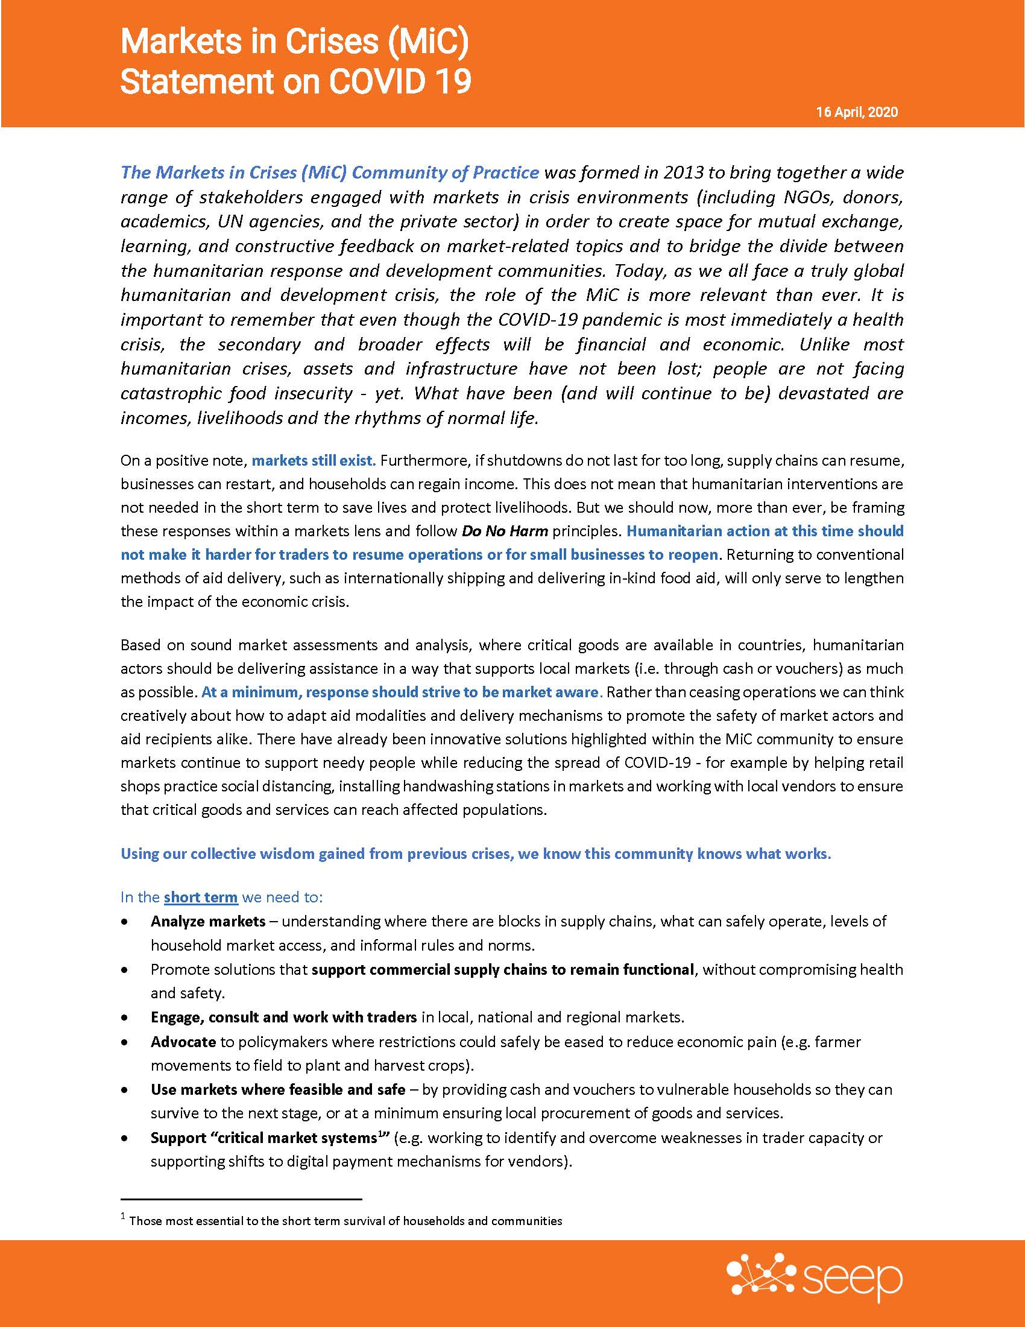
Additional COVID-19 Resources
SEEP Announcements
Upcoming Webinar
How to Address and Prevent Sexual Harassment in the World of Work
May 7 | 9:30 – 10:30 am EDT

