Slide 1
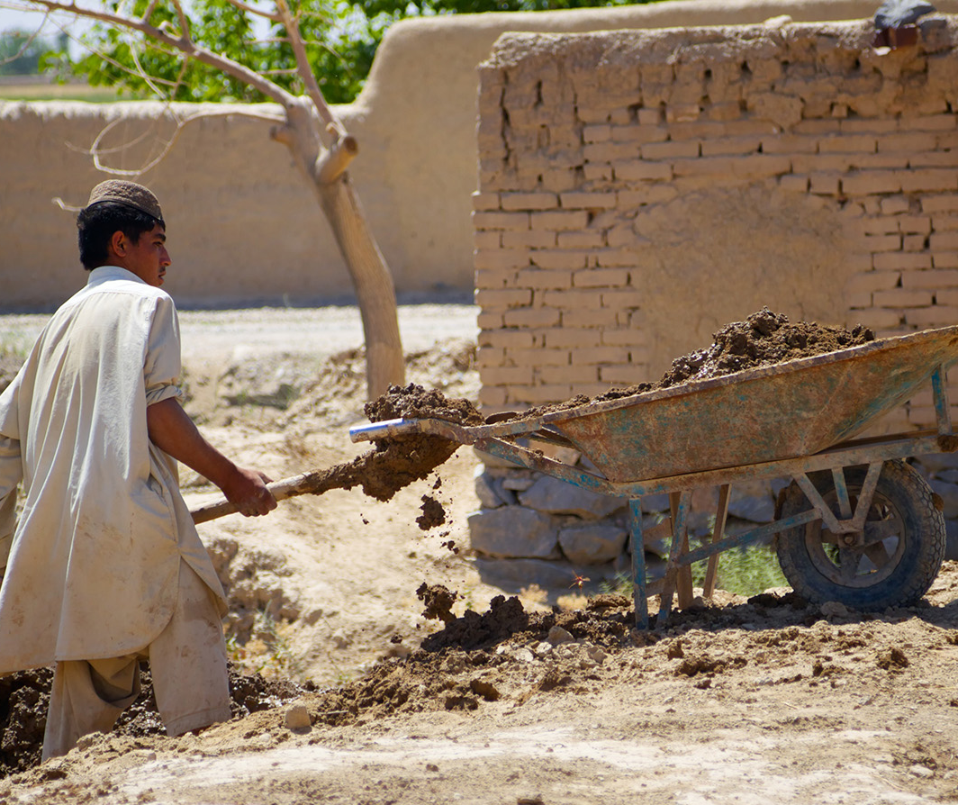
Disaster Promising Risk Reduction for Financial Service Providers: Promising Practices for Building Resilience
Resilient FSPs, Resilient Clients
SPONSORED BY

Slide 2
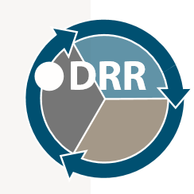
Workshop Objectives
Awareness Raising of DRR Practices for FSPs, Clients and Key Stakeholders
Topics and Objectives:
Discuss DRR concepts and terminology
Identify linkages between hazards, exposure, vulnerability to hazards, capacity and level of risk in DRR
Recognize DRR practices that foster resiliency for FSPs, clients and stakeholders
Practice disaster risk mapping
Knowledge sharing: DRR strategies and approaches across sectors
Notes:
Explanation by facilitator:
After participating in this workshop, participants will be able to:
Discuss and reflect on disaster risk reduction concepts and terminology.
Identify linkages between hazards, exposure to hazards, vulnerability to hazards, and capacity as determinants of the level of disaster risk.
Recognize the relevance of integrating disaster risk reduction into business planning to ensure resiliency and sustainability at client, community and institutional levels.
Share information and knowledge about disaster risk reduction best practices among a diverse group of stakeholders.
Gain experience developing participatory and collaborative partnerships among all relevant stakeholders to further support development of DRR strategies and approaches across sectors Share knowledge about disaster risk reduction best practices among a diverse group of stakeholders .

Slide 3
Workshop Agenda
Facilitators: Add your custom agenda here
Notes:
Facilitator’s Instructions:
Insert Workshop Agenda

Slide 4
Introductions and Experience Sharing
Group Work: Ice Breaker
Take fifteen minutes to introduce yourselves to each member of the table:
Name
Institution
Role
Reflect and discuss guided questions regarding institutional experiences with disaster risk reduction
Notes:
Facilitator Instructions:
This short group session, is intended as an ice-breaker and networking initial time for participants. When participants arrive at their place, they will find a sheet of paper with the following questions for the ice-breaking session.
INTRODUCTIONS AND DISCUSSION
Integration of Disaster Risk Reduction (DRR) in your organization
At your table, please introduce yourselves:
Name
Institution
Role
After introductions, please discuss the following questions:
1. Given that (the name of the country) is a country highly prone to natural-hazards (and possibly, to man-made hazards) related disasters:
Has your organization integrated DRR into its strategic, business, operational and financial planning?
Has your organization developed, implemented, tested, evaluated and updated a business continuity plan, contingency plan, response plan and/or recovery plan?
How important do you think a. and b. are for the long-term sustainable performance of your organization?
2. From your organization’s experience dealing with disasters and their impacts:
How resilient has your organization shown to be? How do you define resiliency for your organization?
What do you think are the lessons learned and key success factors for coping with adversity (becoming more resilient)?
What actions/measures can financial service providers put in place to reduce the impact of unforeseen disastrous events on their loan portfolio, liquidity and solvency?

Slide 5
Module 2
DRR Background, Concepts and Country-Specific Context
Notes:
Facilitator’s Instructions:
Insert Workshop Agenda

Slide 6
DRR Policy Background
Disaster Risk Reduction: Core Policy Objectives
Policy Objectives:
Prevent new disaster risks;
Reduce existing disaster risk;
Managing residual risk
Contributes to:
Strengthening resilience (economic, social, health and environmental)
Achieving sustainable development
Source: UNISDR. 2 February 2017 (http://www.preventionweb.net/english/professional/terminology/)
Notes:
Disaster risk reduction (DRR)
DRR is aimed at preventing new and reducing existing disaster risk and managing residual risk, all of which contribute to strengthening resilience and therefore to the achievement of sustainable development.
DRR is the policy objective of disaster risk management, and its goals and objectives are defined in disaster risk reduction strategies and plans.
This contributes to strengthening resilience (economic, social, health and environmental) and achieving sustainable development (by means of reducing disaster losses)
Goals and objectives of DRR are defined in strategies and plans at local, regional and national levels and in multilateral policies and agreements

Slide 7
DRR Policy Background
Sendai Framework for Disaster Risk Reduction 2015-2030
Voluntary global agreement on Disaster Risk Reduction:
States have the primary role to reduce disaster risk
Shared responsibility: local government, the private sector and other stakeholders
Expected Outcome
“Substantial reduction of disaster risk and losses in lives, livelihoods and health and in the economic, physical, social, cultural and environmental assets of persons, businesses, communities and countries”.
Source: UNISDR. 2 February 2017 (http://www.preventionweb.net/english/professional/terminology/)
Notes:
Sendai Framework for Disaster Risk Reduction 2015-2030
Global, agreed policy of disaster risk reduction
Expected outcome over the next 15 years
“The substantial reduction of disaster risk and losses in lives, livelihoods and health and in the economic, physical, social, cultural and environmental assets of persons, businesses, communities and countries”.

Slide 8
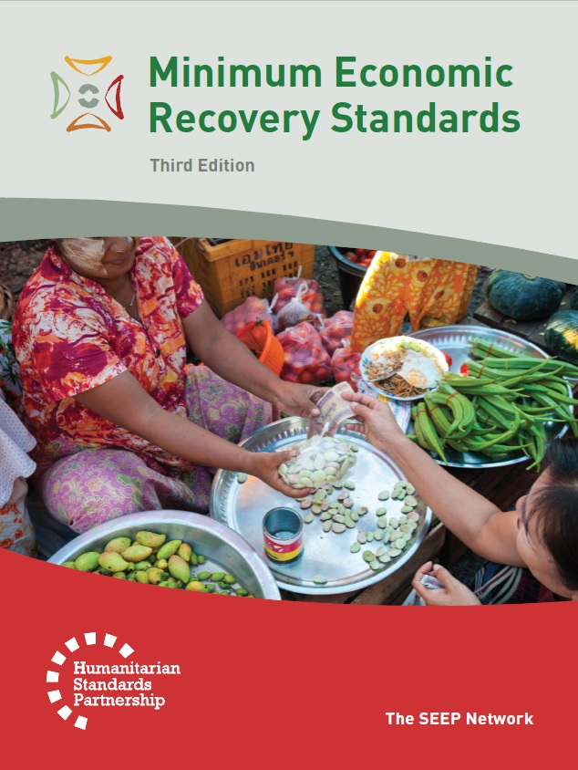
DRR Policy Background
Minimum Economic Recovery Standards (MERS)
“The concept and practice of reducing the risk of disaster through systematic efforts to analyze and manage causal factors. It involves reducing exposure to hazards, lessening the vulnerability of people and property, managing land and the environment wisely, and improving preparedness for adverse events.”
Notes:
The Minimum Economic Recovery Standards or MERS articulate the minimum level of technical and other assistance to be provided in promoting the recovery of economies and livelihoods affected by crisis. The MERS has six technical areas that are interdependent on one another for providing comprehensive relief and humanitarian assistance. These standards offer tools for government departments, humanitarian agencies, inter-governmental organizations, and local populations to enhance the effectiveness and quality of the economic assistance offered, and thus make a significant difference in the lives of the people affected by disasters.
The MERS defines disaster risk reduction as:
The concept and practice of reducing the risk of disaster through systematic efforts to analyze and manage causal factors. It involves reducing exposure to hazards, lessening the vulnerability of people and property, managing land and the environment wisely, and improving preparedness for adverse events.”

Slide 9
DRR Concepts and Terms
Group Work: Definitions
Take fifteen minutes to define and come up with a concrete example for each of the following concepts:
Disaster
Hazard
Exposure
Vulnerability
Pick one or more group members to be a spokesperson
Capacity
Disaster Risk
Resilience
Source: UNISDR. 2 February 2017 (http://www.preventionweb.net/english/professional/terminology/)
Notes:
Facilitator Instructions:
Each table will discuss the core concepts: Disaster; Hazard; Exposure; Vulnerability; Capacity; Disaster Risk; Resilience. Members at each table take 15 minutes to come up with their own definitions and examples for all concepts.
Once the group exercise is finished, for each concept discussed the facilitator will randomly chose one group to present the definition of one concept. The facilitator will take notes in a flip-chart or whiteboard, ask for inputs from the larger group, and provide the internationally accepted concept definition. The same procedure will be applied to all 7 concepts, and each group will have an opportunity to present a definition.
When discussing each of the concepts, the facilitator will show slides 9 thru 15

Slide 10
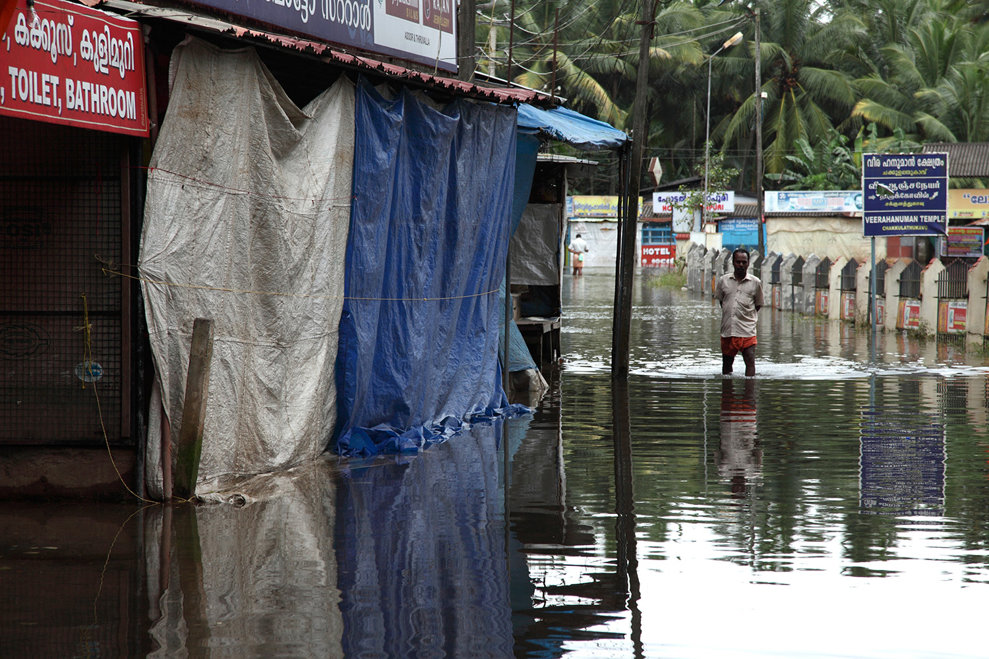
DRR Concepts and Terms
Disaster
Definition
Scale and Frequency
Onset Types
Shutterstock.com
Source: UNISDR. 2 February 2017 (http://www.preventionweb.net/english/professional/terminology/)
Notes:
Disaster Definition:
A serious disruption of the functioning of a community or a society at any scale due to hazardous events interacting with conditions of exposure, vulnerability and capacity, leading to human, material, economic and/or environmental losses and impacts
Damage occurs during and immediately after the disaster - total or partial destruction of physical assets, the disruption of basic services and damages to sources of livelihood in the affected area
Impact is the total effect of a hazardous event or a disaster - may include death, injuries, disease and other negative effects on human physical, mental and social well-being
Disaster Scale and Frequency:
Small-scale disaster
Affects only local communities
Requires assistance beyond the affected community
Large-scale disaster
Affects a large portion of society
Requires national or international assistance
Frequent and infrequent disasters
Depend on the probability of occurrence and the return period of a given hazard and its impacts
Impact of frequent disasters could be cumulative, or become chronic for a community or a society
Disaster Onset Types:
Slow-onset disaster
One that emerges gradually over time
Could be associated with, e.g., drought, desertification, sea-level rise, epidemic disease
Sudden-onset disaster
Triggered by a hazardous event that emerges quickly or unexpectedly
Could be associated with, e.g., earthquake, volcanic eruption, flash flood, chemical explosion, critical infrastructure failure, transport accident

Slide 11
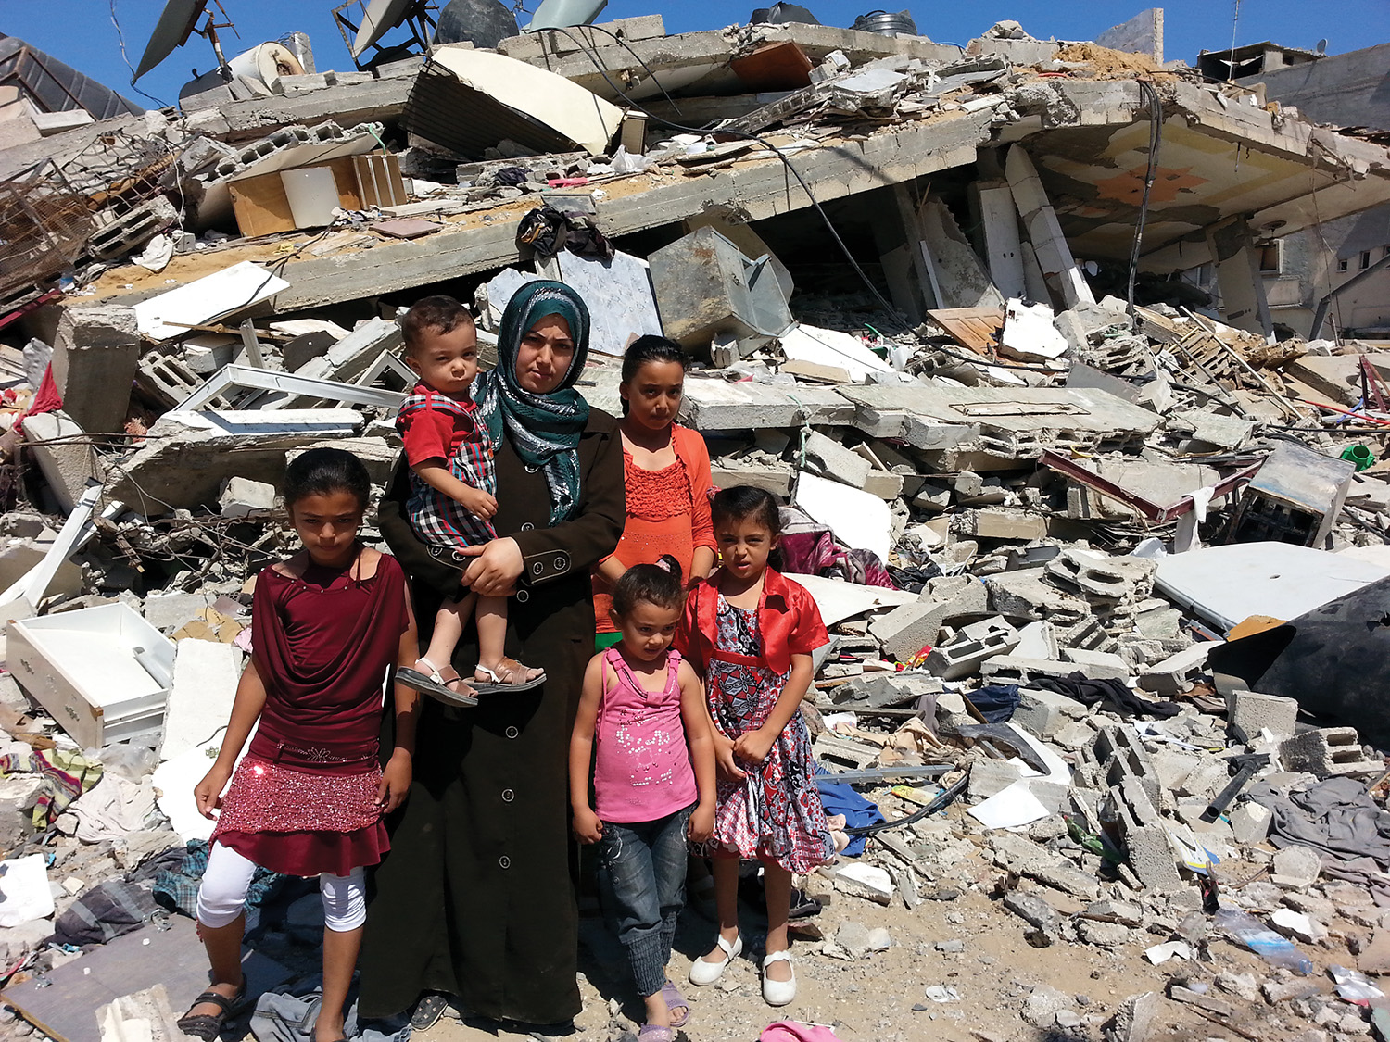
DRR Concepts and Terms
Hazard
Definition
Sources
Types
Source: UNISDR. 2 February 2017 (http://www.preventionweb.net/english/professional/terminology/)
Notes:
Hazard Definition
A process, phenomenon or human activity that may cause:
Loss of life, injury or other health impacts
Damage and loss to property, livelihoods, and services
Social and economic disruption
Environmental degradation
Hazard Sources
Natural: natural processes and phenomena
Anthropogenic or human-induced: induced by human activities and choices
Excludes risk of armed conflict and social unrest
Socio-natural: Combination of natural and anthropogenic (human-induced) factors
Includes environmental degradation and climate change
Types of Hazards
Biological: bacteria, viruses or parasites, insects, mosquitoes carrying disease-causing agents, etc.
Environmental: can be created by environmental degradation or physical or chemical pollution in the air, water and soil
Geological or geophysical: originate from internal earth processes - earthquakes, volcanic activity and emissions, and related geophysical processes such as mass movements, landslides, rockslides, surface collapses and debris or mud flows
Hydro-meteorological: atmospheric, hydrological or oceanographic origin - tropical cyclones (typhoons and hurricanes); floods, including flash floods; drought; heatwaves and cold spells; and coastal storm surges
Technological: originate from technological or industrial conditions, dangerous procedures, infrastructure failures or specific human activities - industrial pollution, nuclear radiation, toxic wastes, dam failures, transport accidents, factory explosions, fires and chemical spills

Slide 12
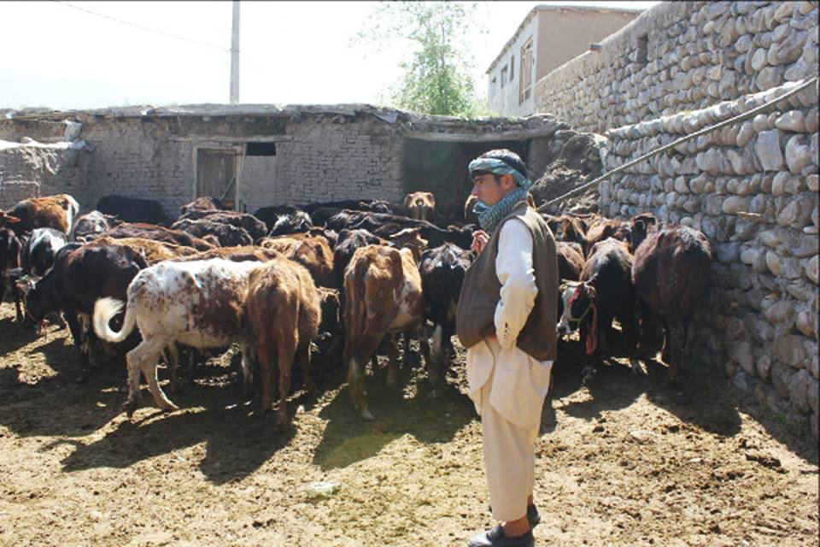
DRR Concepts and Terms
Exposure
Definition
Assets Affected
Source: UNISDR. 2 February 2017 (http://www.preventionweb.net/english/professional/terminology/)
Notes:
Exposure Definition
Tangible human assets located in hazard-prone areas and subject to potential losses.
Types of Assets Affected:
Presence and number of people
Infrastructure and built environment
Housing
Production facilities
Property
Livelihoods
Systems

Slide 13
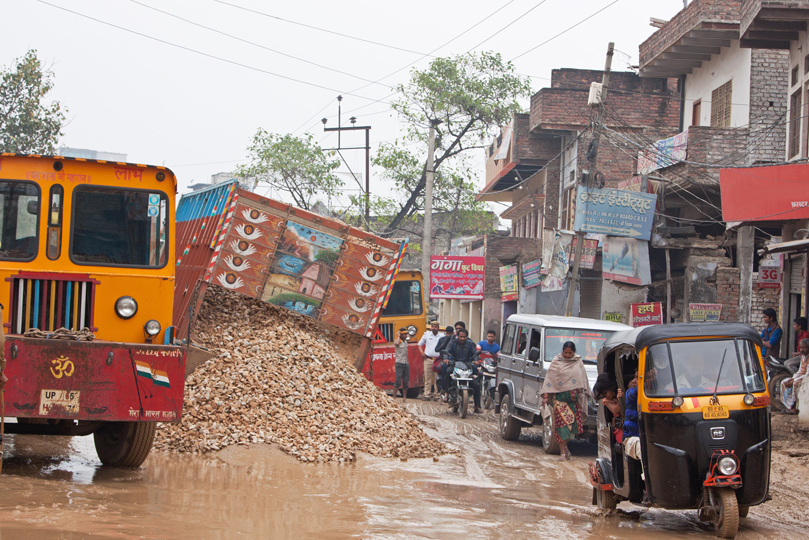
DRR Concepts and Terms
Vulnerability
Definition
Examples
Source: UNISDR. 2 February 2017 (http://www.preventionweb.net/english/professional/terminology/)
Notes:
Vulnerability Definition
Physical, social, economic and environmental factors or processes which increase the susceptibility of an individual, a community, assets or systems to the impacts of hazards. In other words, set of characteristics and circumstances of a community, system or asset that make it susceptible to the damaging effects of a hazard
Examples of vulnerability
Adobe houses (earth dwellings) - very fragile earthquakes, showing poor behavior for moderate to strong ground shakings
Wooden homes are less likely to collapse in an earthquake, but are more vulnerable to fire
When flooding occurs, children, elderly and differently-abled citizens, may be unable to protect themselves or evacuate
Poorer families that live in squatter/marginal settlements are less protected from damaging effects of hazards

Slide 14
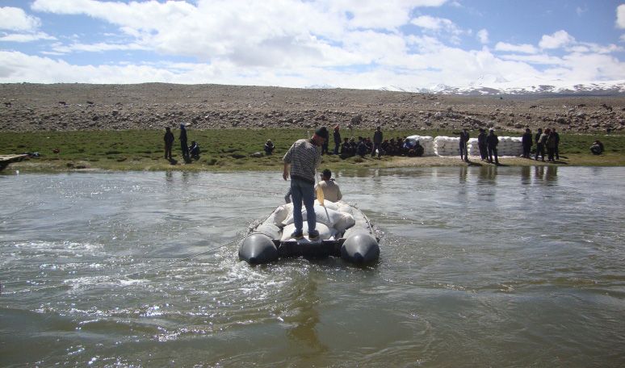
DRR Concepts and Terms
Capacity
Definition
Examples
Source: UNISDR. 2 February 2017 (http://www.preventionweb.net/english/professional/terminology/)
Notes:
Capacity Definition
The combination of all the strengths, attributes and resources available within an organization, community or society to manage and reduce disaster risks and strengthen resilience. Capacity may include infrastructure, institutions, human knowledge and skills, and collective attributes such as social relationships, leadership and management.
Coping capacity is the ability of people, organizations and systems, using available skills and resources, to manage adverse conditions, risk or disasters. The capacity to cope requires continuing awareness, resources and good management, both in normal times as well as during disasters or adverse conditions. Coping capacities contribute to the reduction of disaster risks.
Examples of capacity
Local level organization to adequately respond to adverse events, for example: identification of evacuation routes and meeting points for population, definition of infrastructures that would become shelters or evacuation centers
Information and communication protocols at national, regional and local levels
A national, regional and local DRR system in place, with active and effective committees that have responsibilities regarding the disaster risk management cycle (prevention & mitigation; preparedness; response; recovery, rehabilitation & reconstruction)

Slide 15
DRR Concepts and Terms
Disaster Risk: Linkages of Concepts
RISK = F (Hazard, Exposure, Vulnerability, Capacity)
Source: UNISDR. 2 February 2017 (http://www.preventionweb.net/english/professional/terminology/)
Notes:
Disaster Risk
Forward-looking concept
The potential loss of life, injury, or destroyed or damaged assets which could occur to a system, society or a community in a specific period of time
Determined probabilistically as a function of hazard, exposure, vulnerability and capacity
Risk is a function of ( Hazard, Exposure, Vulnerability, Capacity)

Slide 16
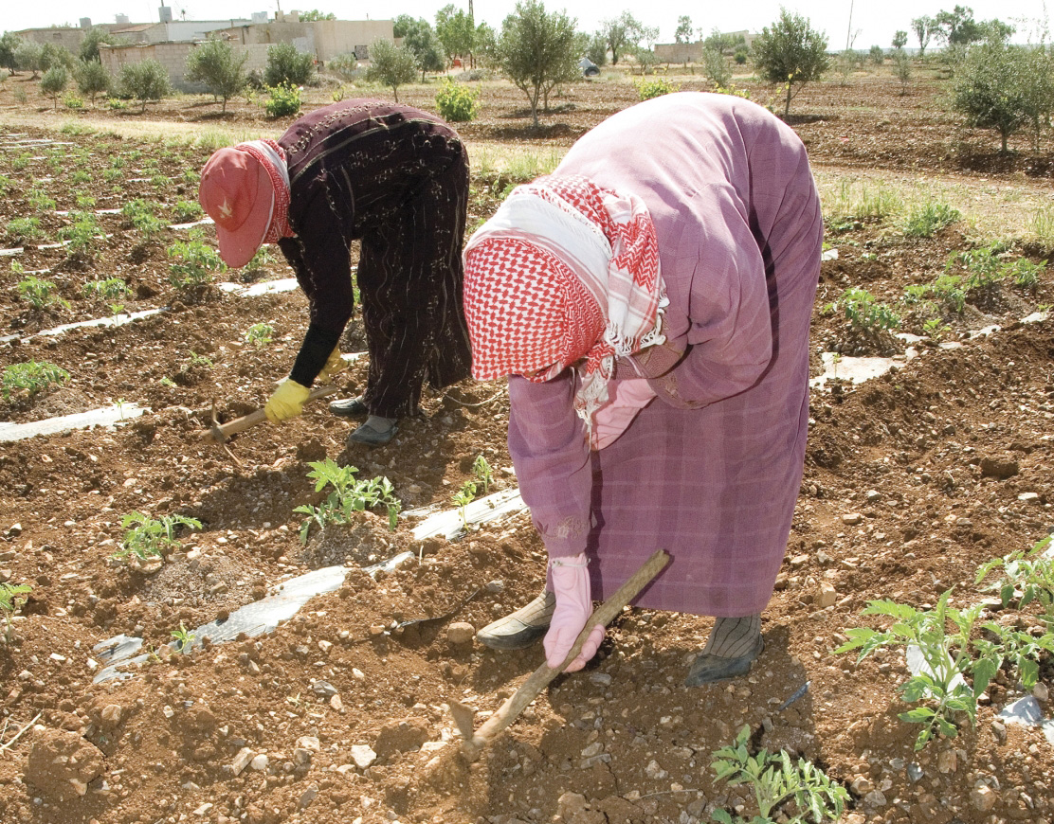
DRR Concepts and Terms
Resilience
Definition
Examples
Sources: The Seep Network. Minimum Economic Recovery Standards. Third Edition. 2017. www.mershandbook.org
UNISDR. 2 February 2017 (http://www.preventionweb.net/english/professional/terminology/)
Notes:
Resilience Definition
Ability of people, households, communities, countries, and systems to mitigate, adapt to, and recover from shocks and stresses in a manner that reduces chronic vulnerability and facilitates inclusive growth
Ability to resist, absorb, accommodate, adapt to, transform and recover from the effects of a hazard in a timely and efficient manner, including through the preservation and restoration of its essential basic structures and functions through risk management
Examples of resilience
A city with flood management infrastructure/drainage systems is resilient to flooding
A city with a large number of buildings equipped to harvest and store rainwater is more resilient to drought
A city with stringent earthquake building codes is more resilient to earthquakes
Sound and enforced land-use planning

Slide 17
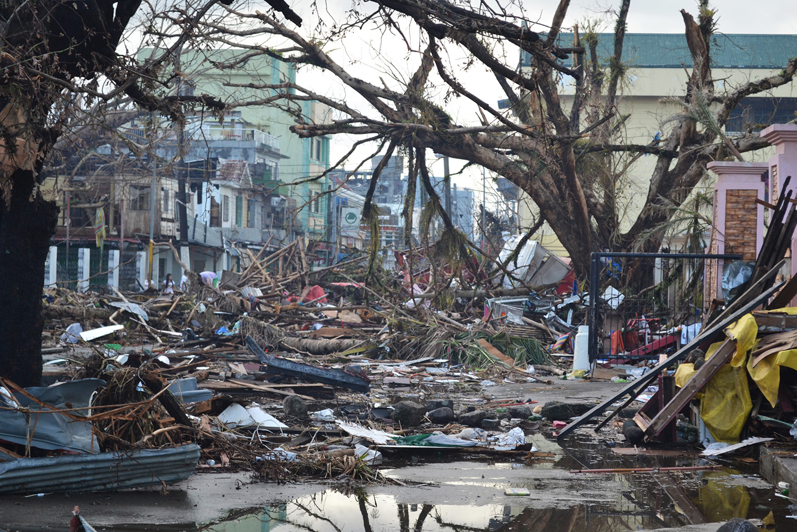
DRR in <insert geographic region/name of the country)
Location-Specific Context
Notes:
Facilitator’s instructions:
Add slides to present a summary of the country-specific context where the workshop is taking place. Include maps and other resources that summarize some of the DRR concepts discussed: exposure, vulnerability, capacity, risk

Slide 18
Module 3
Applying Promising Practices Along the Disaster Risk Management Cycle
Notes:
There are four phases of disaster risk management cycle: 1) preparation and mitigation, 2) preparedness, 3) response, 4) recovery, rehabilitation and reconstruction.
For each phase, we will review some promising practice areas on DRR for FSPs, their clients and key stakeholders. These were based on the extensive resources, case studies and learning outputs developed by the SEEP Network’s global DRR Program.

Slide 19
Promising Practices: Client-Centric Approaches
Context: Why DRR for FSPs?
FSPs focused on financial inclusion are also subject to shocks and stresses
Loan portfolios concentrated in low-income, vulnerable populations with higher exposure to shocks and disasters
DRR can support poor households to diversify income and increase resiliency
Post-disaster response tools are more useful when combined with prevention and preparedness designed to minimize risk for clients
Preparation and prevention help reduce disaster impact and diversify coping mechanisms for FSPs and clients
Notes:
Why is DRR relevant for FSPs, their clients and key stakeholders?
Poor people suffer most because of disasters, as poverty is closely linked to vulnerability conditions.
Why? Because the poor tend to live in areas of high exposure to hazards -floodplains or volcanoes slopes, for example-, and in informal housing lacking structural mechanisms to resist the impact of exogenous events (for example, earthquakes, strong winds, hurricanes).
In addition, poor people tend to have limited possibilities of access to health and education, and a limited level of savings which makes recovery more difficult.
FSPs focused on financial inclusion have their loan portfolios concentrated in low-income populations, that is, people that usually live and work under vulnerable conditions and highly exposed to hazardous events.
Therefore, those FSPs show a tendency to have higher exposure than other financial intermediaries and must increasingly invest resources in prevention/mitigation, and preparedness to ensure their own long-term sustainability.
FSPs that cater the poor (i.e., MFIs) support poor households diversify their income and increase their resilience to different kinds of crises.
Post-disaster response tools are significantly more useful when combined with prevention and preparedness activities designed to reduce and to minimize the risk levels of clients.
Preparation and prevention help reduce the initial impact of a disaster and enable FSPs and their clients to have greater diversity of coping mechanisms.

Slide 20
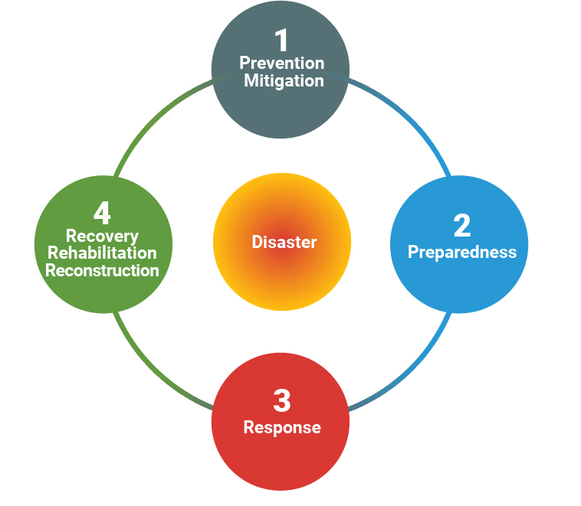
Promising Practices: Client-Centric Approaches
Presentation & Group Work
Activity Overview
For each phase of the cycle:
Definitions
Guided by the handout - take 10 minutes to discuss/share own experiences with promising practices, products, and strategies for FSPs.
Large group will take 5 minutes to reflect on results of the small groups’ experience sharing
Notes:
Facilitator Instructions:
Distribute Briefing Sheet 5 to participants, and give instructions on how the activity is going to be conducted.
Refer to the slide text and facilitator guide for Module 3

Slide 21
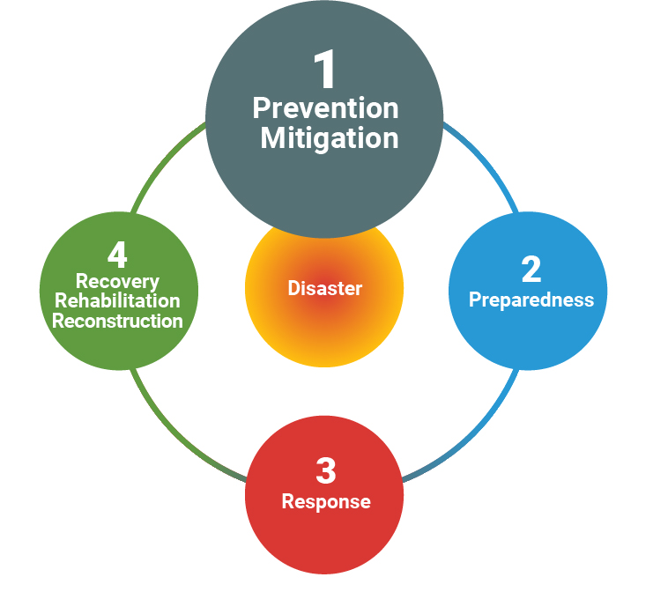
Disaster Risk Management Cycle
Source: UNISDR. 2 February 2017 (http://www.preventionweb.net/english/professional/terminology/)
Notes:
Facilitator’s instructions:
Present the definition of phase 1: Prevention and Mitigation, as a preamble for the group exercise/discussion on promising practices for FSPs regarding prevention and mitigation
PREVENTION
Activities and measures to avoid existing and new disaster risks
Aims at reducing vulnerability and exposure, therefore the risk of disaster is removed
Dams or embankments that eliminate flood risks
Aforestation, reforestation and restoration of wetlands for better flood control
Land-use regulations that do not permit any settlement in high-risk zones (i.e., floodplain zoning)
Seismic engineering designs that ensure the survival and function of a critical building in any likely earthquake
Immunization against vaccine-preventable diseases
Measures taken during or after a hazardous event to prevent secondary hazards or their consequences - measures to prevent the contamination of water
MITIGATION
The lessening or minimizing of the adverse impacts of a hazardous event
Measures include:
Engineering techniques and hazard-resistant construction
Improved environmental and social policies
Public awareness

Slide 22
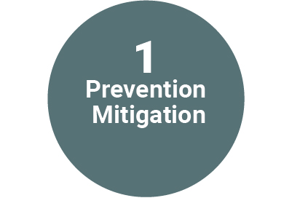
Promising Practices: Prevention & Mitigation
Loan products: improve clients’ quality of life and resiliency to shocks
Savings products: provide a safety net for shocks
Micro-insurance: coping with simultaneous losses of life, health and property
Index-based insurance: pays out benefits on basis of a pre-determined index
Catastrophic Insurance: allows FSPs to write-off loans to business owners impacted by disasters and ensures institutional liquidity
Partial credit guarantee facilities: mitigates partial risk
Technology – Geographic Information Systems (GIS)
Notes:
Facilitator Instructions:
These are some of the key practices that had positive results in this phase, drawn from the case studies developed by SEEP.
Review this before or after the small groups are holding their discussions. (see Module 3 Curriculum for more guidance)
Participants will also have the Briefing Sheet 5 that outlines the Promising Practices from the case studies developed by SEEP
From Briefing Sheet 5: Promising Practices
Phase 1:PREVENTION AND MITIGATION
Loan Products specifically designed to improve quality of life and resiliency to shocks
First Microfinance Bank – Afghanistan developed a housing improvement product (region highly vulnerable to earthquakes, flash floods, landslides)
Hired civil engineers and developed pamphlets and guides to provide technical assistance to clients related to building disaster-resilient structures
During the rollout of the product, over 30 masons and artisans were trained on safe building practices
Provide clients with advice on the selection of building materials, construction techniques, and innovative approaches to improving the safety and quality of their living environments
A demonstration house was built to allow clients and builders to experience and see the building practice
Clients were allowed to select their repayment schedule for the loan product, taking into consideration the cyclical nature of the underlying agriculture cash flows. This flexible repayment schedule improved accessibility and resulted in high repayment rates
SEWA Bank – India
Offers regular housing finance, including loans to repair or replace a roof, wall, floor or door; for monsoon proofing; and for housing expansion or rehabilitation
Savings products
For areas prone to regular disasters, clients can be given an option to save a certain percentage of the approved loan amount to be used in case of emergency to recover from disaster or even for repayment of an existing loan
Microinsurance
Instead of insurance, the poor often rely on savings, depleting or mortgaging their land and assets, emergency loans from MFIs, or money lenders → trapping households in a vicious cycle of poverty. Disaster insurance provides a means to break from poverty by providing a strategy for coping with simultaneous losses of life, health and property
Habitat For Humanity India - Disaster Risk Reduction Insurance
Provides asset and property coverage against a wide range of natural and manmade perils (including severe storms, typhoons, earthquakes, fires, riots, strikes and malicious damage)
Also covers the insured and their family members against accidental death and permanent disability
Spandana Sphoorty Financial Limited (NBFC MFI) – India
Credit life insurance on the disbursed loan amount, with two additional benefits: a small amount of hut insurance and inclusion of spouses in the insurance product
Index-based insurance (good for agricultural/livestock)
Pays out benefits on the basis of a pre-determined index (e.g. rainfall level, seismic activity, livestock mortality rates, wind speed, are yield indices) for loss of assets and investments resulting from weather and catastrophic events
Not designed to protect against every peril, but for situations where there is a larger scale, regional risk (area yield insurance) or well-defined climate risk that significantly influences farmers livelihood
Does not require the traditional services of insurance claims assessors, allowing quicker claims settlement process
Requirements: high quality weather and yield data, a strong enabling environment and extensive awareness raising and education
Catastrophic insurance
FSPs carrying these forms of insurance can write off loans made to business owners whose homes and businesses are destroyed or damaged as a result of natural catastrophes and ensure their own liquidity
Microinsurance Catastrophe Risk Organization (MiCRO) – Guatemala
Re-insurance company owned by re-insurer Swiss RE, Sida, and Mercy Corps
ILO Impact Insurance Facility - Mali
Catastrophic loss could also be held by a government, in particular a regional government, as a means to provide safety-net payments to citizens, in lieu of repeated humanitarian aid cycles
Partial credit guarantee facilities
Mitigate partial risk and typically are placed with FSPs to lend to new market segments, new sectors, or in a new location within a country
Vitas Group – Lebanon
Raised a US$20 million guarantee facility with the Overseas Private Investment Corporation (OPIC) to ease the fear of local banks and encourage them to resume full-scale lending
The facility provided commercial and political risk insurance on any funds lent by local banks
Having a long-term, large-scale guarantee on financing allowed to provide stable, affordable service to the people most critically impacted by war
Technology – Geographic information systems (GIS)
A geographic approach helps protect lives and livelihoods (make countries and communities more resilient) from climate change and the instability it brings to short-term weather patterns
Helps answer a wide variety of questions, such as:
Where are my current and potential customers?
Which areas of my town are most vulnerable to natural disasters?
What is the level of risk of the FSP loan portfolio and facilities due to various natural, socio-natural or anthropogenic hazards?
Benefits organizations of all sizes and every industry in:
Cost savings from greater efficiency
Better decision-making
Improved communication
Better geographic information record keeping
Geographic management

Slide 23
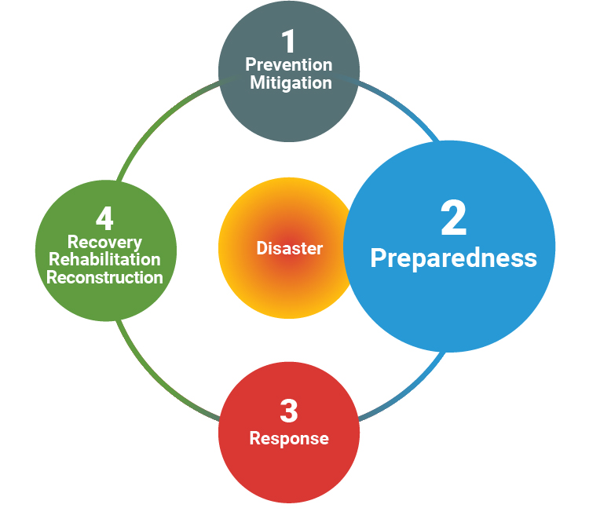
Disaster Risk Management Cycle
Source: UNISDR. 2 February 2017 (http://www.preventionweb.net/english/professional/terminology/)
Notes:
Facilitator’s instructions:
Present the definition of phase 2: Preparedness, as a preamble for the group exercise/discussion on promising practices for FSPs regarding preparedness
PREPAREDNESS
The knowledge and capacities developed by governments, response and recovery organizations, communities and individuals to effectively anticipate, respond to and recover from the impacts of likely, imminent or current disasters
A preparedness plan establishes arrangements in advance to enable timely, effective and appropriate responses to specific potential hazardous events or emerging disaster situations that might threaten society or the environment
Based on a sound analysis of disaster risks and effective linkages with early warning systems, includes:
Contingency planning
Stockpiling of equipment and supplies
Development of arrangements for coordination, evacuation and public information
Training and field exercises

Slide 24
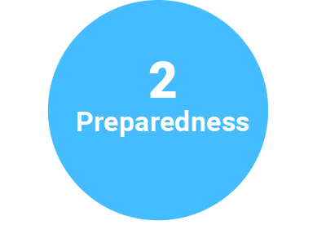
Promising Practices: Preparedness
Liquidity facilities serve immediate needs to stabilize, reduce losses and ensure resiliency of FSPs
Business Continuity Planning: includes DRR context and client specific resiliency response
Governance and management focus: implement strategies that places capable local individuals in leadership positions
Employment practices: local staff invested in the community
Notes:
Facilitator Instructions:
These are some of the key practices that had positive results in this phase, drawn from the case studies developed by SEEP.
Review this before or after the small groups are holding their discussions. (see Module 3 Curriculum for more guidance)
Participants will also have the Briefing Sheet 5 that outlines the Promising Practices from the case studies developed by SEEP
From Briefing Sheet 5: Promising Practices
PREPAREDNESS
Liquidity facilities
Must be established pre-disaster (or conflict)
Serve an immediate need to stabilize, reduce losses and ensure the resiliency of FSPs
Liquidity is critical during and post-crisis:
Potential run on savings as clients want to withdraw funds to purchase necessities and start rebuilding or replenishing assets
Existing clients may also demand new loans to rebuild or for short-term consumption
New clients request loans
Mercy Corps – Indonesia
Vision Fund International – Disaster resilient lending model
Uses liquidity as a tool to rebuild livelihoods and ensure operational capacities of FSPs during times of stress and shock
Emergency Liquidity Facility – Latin America and the Caribbean (2005 – 2015)
Developed to provide short term financing to pre-qualified MFIs within a short period of time (maximum 2 weeks after declaration of emergency by the facility)
Accompanied with a technical assistance facility aimed to help MFIs to better prepare for a crisis (business continuity & contingency planning)
Business continuity planning (BCP)
FSPs should have policies and procedures that are developed, tested and implemented with the local context in mind and that emphasize both client and institutional resilience to respond and recover quickly from risks and crises
Nonetheless, in times of crisis it is crucial that an institution’s strategy, policies and procedures are adapted to reflect the evolving reality on the ground and allow the institution to react effectively and quickly to rapidly changing situations
Essential that an organization’s BCP be context-specific, cannot be generic or copied from organizations in other countries
The ISO 22301 standard defines business continuity as: “...the capability of the organization to continue the delivery of products or services at acceptable predefined levels following a disruptive incident.”
Vitas Group – Middle East
Integration of DRR into overall business planning, so that when disaster does strike, the company is well prepared to manage the impact and respond quickly
Vitas Iraq – rigorous ”hard security” protocols
Develop extremely detailed security practices: real-time communications with all staff, color-coded warning system to inform actions for staff safety, and maintaining agile operations that allow for immediate changes to systems, environments, and staffing to keep business open as much as possible
Regular security trainings for all staff, 24-hour security staff, consultants for specific high-risk movements or events
Keeping a constant ear on the ground with local peers and key security contacts to understand changes to the local environment and act in advance of major disruptions → gives time to move staff and relocate or temporarily close offices until all potential for conflict has passed
First Microfinance Institution Syria
Purpose of BCP: reduce the risks of and time required to resume operations during a situation that affected crucial business operations
BCP clearly outlines priorities around asset security, and staff and client protection during a crisis:
Give branch manager more authority to swiftly and flexibly respond to incidents
Regularly review security conditions across the branch network to identify areas that are not safe for operations and adjust accordingly
If client mobility becomes a challenge in certain areas, FMFI-S offers alternative access points for clients
Frequent testing of evacuation plans
First aid training for staff
Heightened information and database security
Preparation of alternative work sites
First Microfinance Bank - Afghanistan
FMFB-A had a context-specific BCP in place that covered natural disasters and infrastructure, but realized that their plan was not suitable for the increasingly hostile environment; i.e. cash-in-transit policy needed to be region-specific (Kabul - armored vehicles are the norm, the entity transfers cash in armored vehicles; Northern areas - armored vehicles bring attention, transfers cash using discreet method)
Governance and management
First Microfinance Bank - Afghanistan
Capable local individuals are indispensable in the successful management of disaster risks and improved preparedness for adverse events
Business plan includes a detailed 5-year strategy to integrate risk reduction with middle-management skill development
Employment practices
First Microfinance Institution Syria
Staffing the institution from the local community: local staff is more likely to make a long-term commitment and less likely to leave the region during a crisis
Chennai floodings
Close proximity between employees’ places of residence and their worksites was a key dampener
Allow workers participate in the recovery process much faster

Slide 25
Promising Practices: Preparedness
Needs based response: identify on-the-ground realities and needs of clients and respond accordingly
Humanitarian Partnerships: provide humanitarian and social support that complement FSP services
Technology: GIS and geospatial analysis tools support decision-making, scenario evaluation, implementation of early warning system
Notes:
Facilitator Instructions:
After the definition of the phase is given (previous slide), this slide which summarizes the case studies developed by SEEP is shown to participants to refer to while they discuss/share their own experiences with promising practices, products, and strategies for FSPs. Participants will also have the handout that summarizes the case studies developed by SEEP
PREPAREDNESS
Needs Based Response
First Microfinance Institution Syria
Understand on-the-ground realities and needs of clients and respond accordingly → develop client centric products, services and delivery channels
Humanitarian partnerships
First Microfinance Institution Syria
Building and maintaining partnerships with specialized agencies that provide humanitarian and social support that complement FSPs financial services
First Microfinance Bank – Afghanistan
AKF Afghanistan, Mercy Corps, and ACTED: program to improve alternative livelihoods for vulnerable populations
Aga Khan Planning and Building Services: offer expert construction advisory services
Share information and security resources with other AKDN agencies that face similar security issues (theft, terrorism, insurgency, business espionage) to present a united front against possible threats
Technology
GIS and geospatial analysis tools contribution to FSPs
Better account for risks: support decisions and reduce exposure. For example: better assess the loan portfolio risk profile for individual threats or multi-threats scenarios
Improve risk understanding and more accurately model impacts for better decision-making. For example: Evaluate financial scenarios for exposures to individual threats or multi-threats scenarios
Develop new loan products to improve clients’ resilience to threats (reduce their vulnerability), for adaptation or mitigation of their exposure to hazards (i.e., climate change)
Implement an early warning system for clients, personnel and branches located in areas exposed to different typologies of hazards

Slide 26
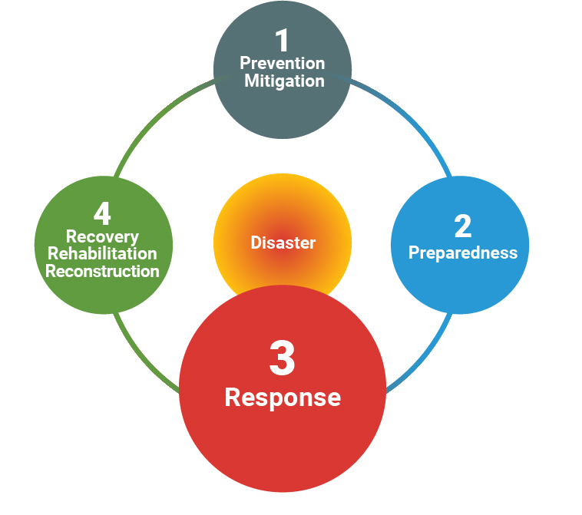
Disaster Risk Management Cycle
Source: UNISDR. 2 February 2017 (http://www.preventionweb.net/english/professional/terminology/)
Notes:
Facilitator’s instructions:
Present the definition of phase 3: Response, as a preamble for the group exercise/discussion on promising practices for FSPs regarding response
RESPONSE
Actions taken directly before, during or immediately after a disaster in order to save lives, reduce health impacts, ensure public safety and meet the basic subsistence needs of the people affected
Predominantly focused on immediate and short-term needs - also called disaster relief
Effective, efficient and timely response relies on disaster preparedness measures, including the development of response capacities of individuals, communities, organizations, countries and the international community

Slide 27
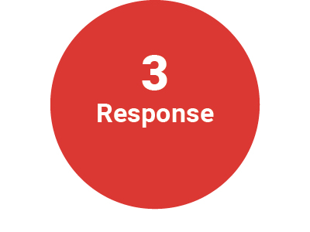
Promising Practices: Response
Employment practices: support staff in affected areas managing the personal and emotional toll associated with crisis – counselling, phone trees, life insurance
Loans: product review/adaptation, rescheduling/restructuring & refinancing, forgiveness/write-offs, emergency loans, overdraft limits
Relief Funds and Supplies: cash and/or packages to clients to cover basic needs
Notes:
Facilitator Instructions:
These are some of the key practices that had positive results in this phase, drawn from the case studies developed by SEEP.
Review this before or after the small groups are holding their discussions. (see Module 3 Curriculum for more guidance)
Participants will also have the Briefing Sheet 5 that outlines the Promising Practices from the case studies developed by SEEP
From Briefing Sheet 5: Promising Practices
RESPONSE
Employment practices
First Microfinance Institution Syria
Greatly concerned with supporting its staff during the crisis: access to fuel and other emergency staples, life insurance, family support, and crisis counselling
Vitas Lebanon
During the war, focused its efforts on core humanitarian risks, checking in on staff constantly and moving them from one place to another as needed to stay safe
Vitas Palestine
Most complex challenge was managing the personal and emotional toll the war had on staff in Gaza: they needed services before they could help others
Set up phone trees and a schedule so that someone from the West Bank called each staff person in Gaza at least four times a day
West Bank called each staff person in Gaza at least four times a day to check in on their physical and emotional health and identify people in immediate need of greater assistance
West Bank staff listened to their stories and encouraged them to give it another day to stay safe for their families and for the clients who desperately needed help
Within 10 days following the end of fighting, Gaza staff were all safe and reported feeling very happy to have been able to help clients when they felt so helpless in other ways
Loan products review/adaptation
First Microfinance Institution Syria
Raise the ceiling for microloans to answer to clients’ declining purchasing power
Lower the area stability requirement from 6 months to 3 months
Allow loans for start-up projects
Design new products around alternative power sources - purchase generators, batteries, electric stabilizers and solar panel water heating devices
Expanded permissible uses of the housing loan: include consumer needs (fuel and household commodities)
Revised small business loan: meet reconstruction needs of businesses striving to rebuild in a crisis environment
Vitas Lebanon
Adapted the terms on its standard microfinance loans to help business regain prior footholds in the market and get back on a path to growth that would help restart local economies
Loan rescheduling/restructuring/refinancing
First Microfinance Institution Syria
Policy set criteria to determine eligibility, including assessment of asset damage and cash flow projections
To be done on an immediate and case-by case basis to avoid portfolio contamination
Standard six-month grace period allowed clients to use loan proceeds productively to rebuild capacity
First Microfinance Bank – Afghanistan
Rapid and well-targeted to help clients recover, adjust to income shocks quickly, and avoid disaster-induced defaults
Vitas Palestine
Refinancing loan to help cover and close out existing loans
Included a small top-off amount and a grace period of up to six months, depending on need
India’s microfinance sector & Chennai floodings
Emergency loans
India’s microfinance sector
Non-preapproved emergency loan of very small value to support clients in case of medical or similar needs
Vitas Lebanon
Short-term emergency loan to help new or existing clients bridge the gap between the essential cost of living and available resources
Vitas Palestine
Emergency loan of up to $5,000 with a simplified, lower interest rate for new clients who needed help to recover
Loan forgiveness
First Microfinance Institution Syria
In cases of client’s death or irrecoverable loss of livelihood
Applied on a case-by-case basis
Confidential in order to avoid moral hazard and other concerns
Loan write-offs
Vitas Palestine
US$125,000 worth of loans were written off for businesses that were completely destroyed
70% of those clients have paid back those loans on their own accord, without any legal action or pressure, so that they could keep a clean credit history with the local regulators and have access to credit again in the future
Overdraft limits
Chennai floodings
Extension of overdraft limits by 10-15%, but these were deemed inadequate and inaccessible
Relief funds & supplies
First Microfinance Bank – Afghanistan
Disbursed relief funds in partnership with AKF Afghanistan to drought affected communities
India’s microfinance sector
Use of technology to ensure cash-less and quick transfer of relief funds
Vitas Palestine
With Global Communities and World Food Programme (WFP) deliver relief supplies/packages to the 1,300 clients most in need (homes and livelihoods had been destroyed)
Cash transfer resilience tool
Cash, as opposed to in-kind aid, often increases choice, control, and convenience for recipients
Cash transfers through FSPs can improve speed, efficacy and security of humanitarian aid delivery
Can offer long-term opportunities for transitioning recipients into FSPs clients → help them achieve greater financial inclusion and resiliency after the crisis

Slide 28
Promising Practices: Response
Savings and Deposits Services: provide clients with a secure place for savings, accessible withdrawal in case of internal displacement, collateral for loans
Client Relationship Practices: to understand how clients have been impacted and monitor displacement
Technology:
GIS and geospatial analysis tools to focus on directly impacted clients first
Facilitates business and operational planning during the crisis period (portfolio and liquidity management)
Notes:
RESPONSE Continued
Savings/deposits services
First Microfinance Institution Syria
Focused on offering a secure place for clients to store their savings, a convenient branch-to-branch transfer, and withdrawal service during periods of internal displacement
Clients were also offered the option to use their savings as collateral for a loan at a proportion that varied with their circumstances
Allowed clients to withdraw from their fixed term deposits without penalty at any time
Considering a scheme that will grant rewards to clients for maintaining specified savings levels
Client relationship practices
Vitas Lebanon
Monitored clients at regular intervals to see whether they had been displaced and how their families and businesses were performing
NO emphasis on loan recovery
Vitas Palestine
Surveyed all 2,600 clients in Gaza to better understand who was impacted and how deeply (allow to determine which clients will need relief assistance packages)
No clients were asked about their loans at this time
Technology
GIS and geospatial analysis tools
Quickly identify clients located in affected areas that might need support from the FSP and other relevant actors in humanitarian response
Allows for more effective and efficient response, focusing on directly impacted clients first
Assess potentially affected loan portfolio, need for rescheduling/restructuring/refinancing, demand for emergency loans, savings withdrawal, and microinsurance claims = business and operational planning
Evaluate financial impact on the FSP, and potential needed support from liquidity facilities, guarantee schemes, etc. = financial planning

Slide 29
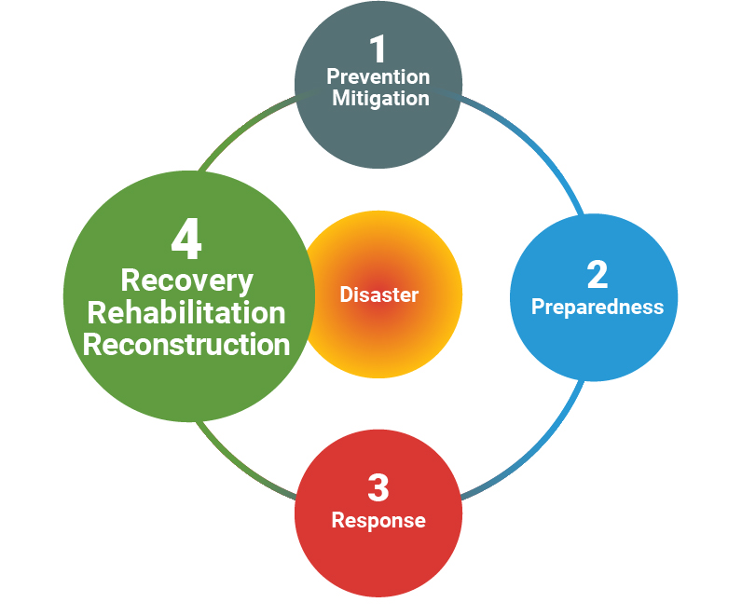
Disaster Risk Management Cycle
Source: UNISDR. 2 February 2017 (http://www.preventionweb.net/english/professional/terminology/)
Notes:
Facilitator’s instructions:
Present the definition of phase 4: Recovery, rehabilitation and reconstruction, as a preamble for the group exercise/discussion on promising practices for FSPs regarding recovery, rehabilitation and reconstruction
RECOVERY
The restoring or improving of livelihoods and health, as well as economic, physical, social, cultural and environmental assets, systems and activities, of a disaster-affected community or society, aligning with the principles of sustainable development and “build back better”, to avoid or reduce future disaster risk
REHABILITATION
The restoration of basic services and facilities for the functioning of a community or a society affected by a disaster
RECONSTRUCTION
The medium- and long-term rebuilding and sustainable restoration of resilient critical infrastructures, services, housing, facilities and livelihoods required for the full functioning of a community or a society affected by a disaster, aligning with the principles of sustainable development and “build back better”, to avoid or reduce future disaster risk
Build back better
The use of the recovery, rehabilitation and reconstruction phases after a disaster to increase the resilience of nations and communities through integrating disaster risk reduction measures into the restoration of physical infrastructure and societal systems, and into the revitalization of livelihoods, economies and the environment.

Slide 30
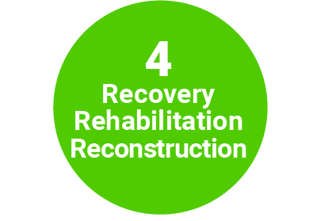
Promising Practices: Recovery, Rehabilitation and Reconstruction
Reconstruction loans for pre-existing clients with partial or significant loss of business and/or house to rebuild assets and livelihoods (longer term, higher amounts)
Notes:
Facilitator Instructions:
These are some of the key practices that had positive results in this phase, drawn from the case studies developed by SEEP.
Review this before or after the small groups are holding their discussions. (see Module 3 Curriculum for more guidance)
Participants will also have the Briefing Sheet 5 that outlines the Promising Practices from the case studies developed by SEEP
From Briefing Sheet 5: Promising Practices
RECOVERY, REHABILITATION AND RECONSTRUCTION
First Microfinance Institution Syria
Business reconstruction loans to existing clients who had experienced partial or significant loss of business assets but demonstrated capacity to continue to generate revenue
Vitas Lebanon
Longer-term reconstruction product for individuals whose businesses and/or houses were damaged in the war
India’s microfinance sector
Based on the performance of clients, a credit option for larger amounts can be made available for livelihood generation or asset rebuilding

Slide 31
The DRR Management Cycle and Promising Practices
Plenary Discussion
Notes:
Use this time to review the most relevant phases again.
Ask participants which practices across the cycle were the most important for them in their work.
Solicit any surprising or interesting point they want to revisit and reinforce.

Slide 32
Module 4
Disaster Risk Mapping Toolkit:
The Impacts on FSPs
and Their Clients

Slide 33
DRR Mapping Toolkit
IFMR-India and SEEP Network
Objectives
Maps country risk environment for MFIs and their clients: i.e. risk events, operational readiness, client vulnerability, ecosystem factors
Identifies opportunities to build resilience among MFIs and their clients through greater disaster preparedness
Creates awareness of the opportunities for improved coordination among a range of public and private actors
Establishes a framework for sustained dialogue around DRR for the MFI sector through sharing promising practices and lessons learned

Slide 34
DRR Mapping Toolkit
IFMR-India and SEEP Network
DRR Mapping Purpose:
Map disaster-related vulnerabilities of MFI clients
Assess gaps in disaster preparedness among key market actors: MFIs, NGOs and government entities
Collect data to inform national DRR engagement strategies
Toolkit Purpose:
Provide a model for replicating similar studies for disaster-prone environments
Equip FSPs and other market actors to identify current practices and gaps in the sector
Disseminate lessons learned in the mapping process

Slide 35
DRR Mapping Toolkit
IFMR-India and SEEP Network
Outcomes – DRR Mapping from Indian FSP market
Strengthen Stakeholder Involvement: Engage MFIs through aggregators and associations
Assure Trust: Address confidentiality/anonymity concerns of regulators and industry players with clearly articulated confidentiality agreements
Build Awareness and Knowledge: Standardize definitions across communications; perform follow up consultations to increase exposure and validate primary and secondary research
Minimize Bias Through Cross-Sectoral Consultation: Involve all members of the DRR/MFI ecosystem to ensure balanced perspective

Slide 36
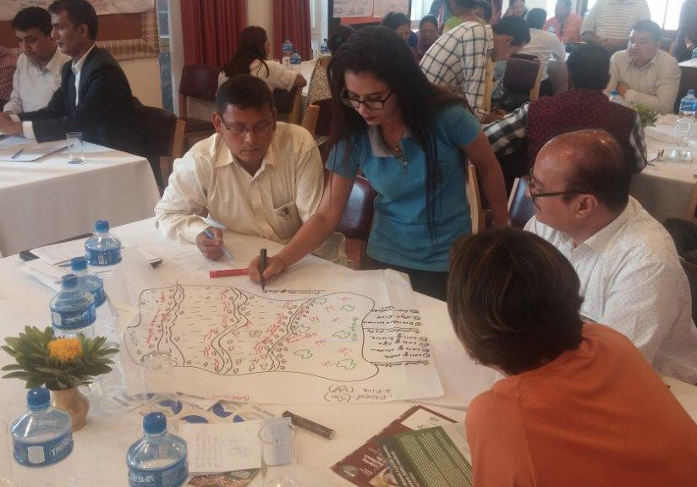
Mapping Exercise
Community Mapping of Disaster Risks
Notes:
Choose a territory/geographic location to assess and conduct the mapping exercise
List the natural, socio-natural and anthropogenic-related hazards to which the chosen territory is exposed to – earthquakes, volcanic eruption, hurricane/typhoon/cyclone, floods, drought, landslides, tornados, avalanches, hail storm, snow storm, tsunami, explosions, criminality, etc.
Draw a map of the territory to be assessed (see Figure 1 below for an example of this visual tool), identifying:
Vulnerable/prone zones to the natural, socio-natural and anthropogenic-related hazards listed – areas that historically, currently or potentially could be affected, and assess the probability of occurrence of the natural-related hazards to which it is exposed – HIGH, MEDIUM, LOW
Areas where FSPs’ clients are located/concentrated (households and businesses)
Safe areas for relocation of houses or economic activities, safe areas for evacuation (shelters, sport facilities, stadiums, school yards)
Based on above information, assess expected impact on FSPs and their clients in case of materialization of the identified natural, socio-natural, and anthropogenic-related hazards. For example, if the FSP works in a sector with high probability of flooding or landslides during the rainy season, high level of concentration of clients’ homes and businesses, and medium to high probability of loss of clients’ assets:
What could be the potential impact on clients’ livelihoods, capacity to repay their loans, savings withdrawals, etc.?
Given the answer to the previous questions, what could be the potential impact on the FSPs’ performance (growth, quality of assets, liquidity, capital, etc.)
Alternatively, the groups could be handed maps of well-known areas for participants to perform the exercise

Slide 37
Mapping Exercise
Group Work: Disaster Risk Mapping
Activity Overview
Self-mapping of exposure, natural-related hazards, vulnerabilities, risks, and coping mechanisms
5 to 6 groups consisting of 6 people
Follow four step process for disaster risk mapping (see next slide)
Two people stay with their map to act as spokespeople
Other participants will tour around the room to analyze and discuss group maps
5 minutes review at each map

Slide 38
Mapping Exercise
Exercise Methodology
Step 1:
Step 2:
Step 3:
Step 4:
Step 5:
Choose a territory to assess and conduct the mapping exercise
List the natural-related hazards for the territory being assessed
Draw a map of the area/territory to be assessed
Use info from Step 1 (hazard listing) and Step 2 (territory mapping), prioritize areas based on probability of exposure to natural-related hazards and expected impact on FSPs and their clients
Brainstorm ways to work together to create more resilient livelihoods for clients and FSPs
Notes:
STEP 1
Choose a territory/geographic location to assess and conduct the mapping exercise
STEP 2
List the natural-related hazards for the territory being assessed: earthquakes, volcanic eruption, hurricane/typhoon/cyclone, floods, drought, landslides, tornados, tsunami
STEP 3
Draw a map of the area/territory to be assessed
Maps are a proven method of communicating geographic knowledge
Maps are visual tools that help participants analyze problems, describe local situations, and assess community assets and infrastructure
Map should identify:
Vulnerable/prone zones to the natural-related hazards listed – areas that historically, currently or potentially could be affected, and assess the probability of occurrence of the natural-related hazards to which it is exposed – HIGH, MEDIUM, LOW
Areas where FSPs’ clients are located or concentrated (households and businesses)
Safe areas for relocation of houses or economic activities, safe areas for evacuation (shelters, sport facilities, stadiums, school yards)
STEP 1
Choose a territory/geographic location to assess and conduct the mapping exercise
STEP 2
List the natural-related hazards for the territory being assessed: earthquakes, volcanic eruption, hurricane/typhoon/cyclone, floods, drought, landslides, tornados, tsunami
STEP 3
Draw a map of the area/territory to be assessed
Maps are a proven method of communicating geographic knowledge
Maps are visual tools that help participants analyze problems, describe local situations, and assess community assets and infrastructure
Map should identify:
Vulnerable/prone zones to the natural-related hazards listed – areas that historically, now or potentially could be affected, and assess the probability of occurrence of the natural-related hazards to which it is exposed – HIGH, MEDIUM, LOW
Areas where FSPs’ clients are located or concentrated (households and businesses)
Safe areas for relocation of houses or economic activities, safe areas for evacuation (shelters, sport facilities, stadiums, school yards)
STEP 4
Use info from Steps 1 (hazard listing) and Step 2 (territory mapping), and assess expected impact on FSPs and their clients if these natural-related hazards happen.
For example, if the FSP works in a sector with high probability of flooding or landslides during the rainy season, high level of concentration of clients’ homes and businesses, and medium to high probability of loss of clients’ assets:
What could be the potential impact on clients’ livelihoods, capacity to repay their loans, savings withdrawals, etc.?
Given the answer to the previous questions, what could be the potential impact on the FSPs’ performance (growth, quality of assets, liquidity, capital, etc.)?
STEP 5
Brainstorming on mechanisms that FSPs could put in place to create more resilient livelihoods for clients and for FSPs themselves.
For example:
Relocation of economic activities or housing
Diversification of productive activities of FSPs’ clients away from high-risk activities
Financial products/services adapted/centered on clients’ needs - credit, savings, insurance
Non-financial services - technical assistance, training, capacity building, early-warning systems
Public and private partnerships for DRR

Slide 39
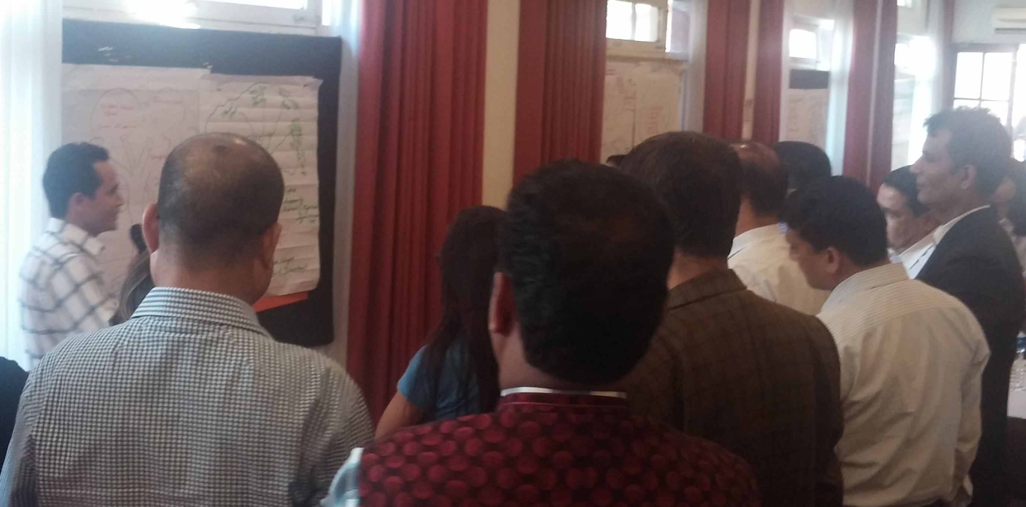
Gallery Walk
Walking Tour to View Others’ Maps

Slide 40
Module 5
Global Lessons Learned and Workshop Reflection

Slide 41
Lessons Learned
Realities of DRR Approaches from Vitas Group
DRR: Constant work in progress
Should be part of every business plan
Approach should reviewed after every new incident to make improvements in future responses
A senior person should be directly responsible for overseeing the process

Slide 42
Lessons Learned
Realities of DRR Approaches from Vitas Group
Financial services are more crucial when:
Basic needs are exacerbated
New or more urgent needs must be met in the face of cash shortages
Requires reinforced commitment to lending during times of crises

Slide 43
Lessons Learned
Realities of DRR Approaches from Vitas Group
FSPs should always have a crisis management plan as part of its risk management framework, even in low-risk security environments
A robust plan should involve:
Constant communication with all stakeholders
Flexibility: All team members must be prepared to shift plans and accommodate rapid changes
Staff and client well-being = first priority → portfolio concerns secondary
Tactics to manage emotional and physical well-being of staff before, during, and after stressful situations

Slide 44
Lessons Learned
Realities of DRR Approaches from Vitas Group
When assessing the portfolio, help clients recover before writing-off loans
Rescheduling loans or providing additional emergency funds → helps clients get back on their feet while preserving the viability of the business
Writing-off loans hurts the FSP and affects a client’s credit history and future ability to obtain credit

Slide 45
Lessons Learned
Realities of DRR Approaches from Vitas Group
To create stability, look for new ways to preserve liquidity in times of crisis
Loan guarantees or other instruments are excellent ways to mitigate risk, but take time and advance planning to structure → start early and begin building relationships before crisis strikes

Slide 46
Key Takeaways and Ways Forward
Open Discussion
What do you feel are the most important key takeaways from this workshop?
How might the best practices, lessons learned and other information be applied to your work going forward?

Slide 47
Workshop Feedback
Workshop – Assessment and Evaluation
Open feedback and discussion
Content: Too much, not enough, just right?
Balance of activities: Good balance of lecture and activities?
Other feedback?
Survey evaluation

Slide 48
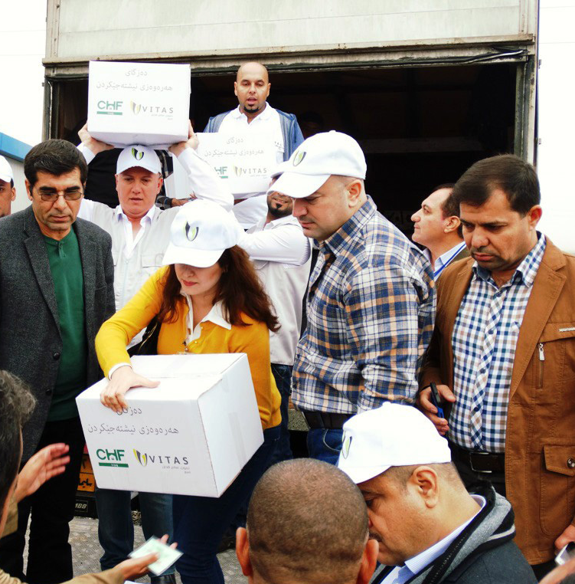
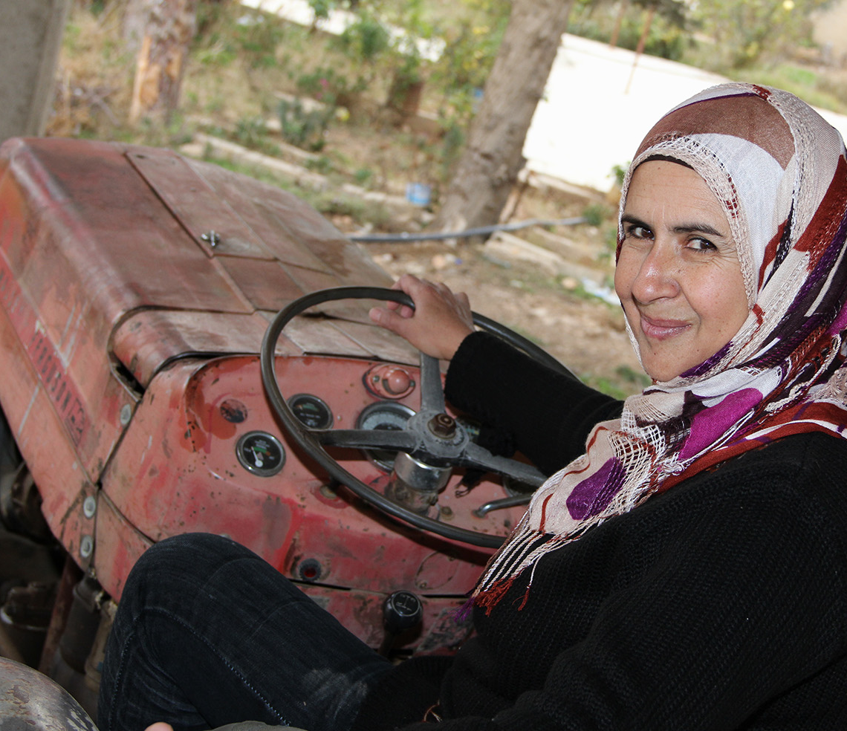
Closing Remarks

Slide 49
Thank you!
Please Keep In Touch
Facilitators: add your contact information here

Slide 50
Bibliographic References
Castro-Monge, Ligia. Exogenous risk management in financial institutions that serve the most vulnerable segments of the population. June 2011
CGIAR Research Program on Climate Change, Agriculture and Food Security (CCAFS). Scaling up index insurance for smallholder farmers: Recent evidence and insights. CCAFS Report No. 14. 2015
ESRI. What is GIS? July 2012
FAO. The impact of disasters on agriculture and food security. 2015
International Rescue Committee, Citi & SEEP. Cash Transfer Resilience Tool. 2016
Mercy Corps. Financing the frontier: inclusive financial sector development in fragility-affected states in Africa. February 2017
Mercy Corps & Okapi. Transforming Chennai. A research report on building micro, small, and medium enterprise resilience to water-related environmental change. November 2016
Munich Re. Natural catastrophe losses at their highest for four years. Press release. January 2017
Pakistan Microfinance Network. Post-floods microfinance in Pakistan. An assessment of 2010 floods. 2012
Notes:
Facilitator’s instructions:
Any new references used in developing the country specific context (module 2) or the mapping activity (module 4) could be added here.

Slide 51
Bibliographic References
Red de Instituciones Financieras de Desarrollo. Post-disaster recovery and response plan for development finance institutions. Response manual Ecuador 2016. Technical Guidebook. August 2016
SEEP. First Microfinance Institution Syria: Building resilience through a client-centric model. Case study in disaster risk reduction. 2016
SEEP. Fostering resilience in the Middle East: A people centered approach to risk reduction. Case study in disaster risk reduction. 2016
SEEP. The First Microfinance Bank – Afghanistan (FMFB-A): Building resilience through a client-centric model. Case study in disaster risk reduction. 2016
SEEP & Habitat for Humanity India. Habitat for Humanity India’s Disaster Risk Reduction Insurance. Case study in disaster risk reduction. 2016
SEEP & IFMR LEAD. Building resilience through disaster risk reduction: an assessment of India’s microfinance sector. Report. March 2017
The SEEP Network. Minimum Economic Recovery Standards. Third Edition. 2017

Slide 52
Bibliographic References
Turnbull, Marilise; Sterrett, Charlotte L. & Hilleboe, Amy. Toward resilience. A guide to disaster risk reduction and climate change adaptation. CRS. 2013
United Nations. Sendai Framework for Disaster Risk Reduction 2015-2030. 2015
United Nations University & Institute for Environment and Human Security. World Risk Report 2016. Not dated
Yemen Microfinance Network. Microfinance in Yemen. Hopes vs. Reality. July 2015

